Slide 1
Final Report Wind Turbine Blade Design
Internship Project
Adviser: Prof. Fei-Bin Hsiao
Reporter : Mr.Kiatbordin Loorungroj
Ms. Nattirat Promwang
May 28th,2013

Slide 2

Outline
Theories
Calculation processes
MATLAB Output
Soildworks
Discussion
Conclusion

Slide 3
Objectives
To gain the theoretical knowledge of Blade Element Momentum Theory (BEM)
To apply BEM to design wind turbine blade shape and performance

Slide 4
Design Plan
Horizontal Axis Wind Turbine (HAWT)
Small wind turbine with 3 blades
1250 W power input
5 degree of initial angle of attack
Tip speed ratio (λ) of 6
RPM from 0 to 900
Wind speed from 3 to 12 m/s

Slide 5
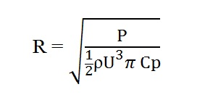

Calculation Processes
Calculate Efficient Radius (R) from 1D-Momentum Theory
Locate the radius at blade root and tip
Subdivide the blade into 10 sections

Slide 6
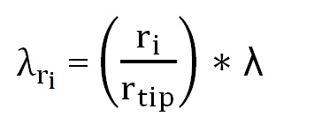


Calculation Processes
4. Determine “Local tip speed ratio”
5. Find the value of angle of relative wind
6. Find the value of blade pitch angle

Slide 7
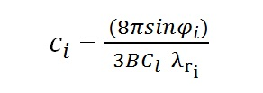


Calculation Processes
7. Calculate the chord length
8. Determine “Local Solidity”
9. Determine relative velocity

Slide 8


Calculation Processes
10. Redesign pitch angle
11. Recalculate angle of attack

Slide 9
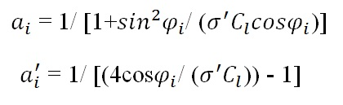

Calculation Processes
12. Determine axial and angular induction factors
13. Recalculate tip speed ratio

Slide 10



Calculation Processes
13. Calculate torque
From Momentum Theory
From Blade Element Theory
14. Calculate power coefficient

Slide 11
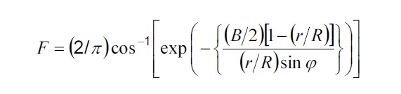
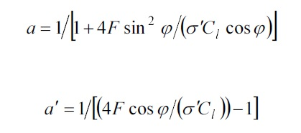

Calculation Processes
Problem due to “Tip Loss”

Slide 12


Calculation Processes
Problem due to “Tip Loss”

